Slide 1
Youth Climate Communication & Action
Week 13

Slide 2
Agenda
1. Check-In Activity
2. Reading Debrief
3. Mapping Power Activity
Break!
4. Debrief & Share Out
5. Options (Paper/Planning/Etc.)

Slide 3
How was yesterday?

Slide 4
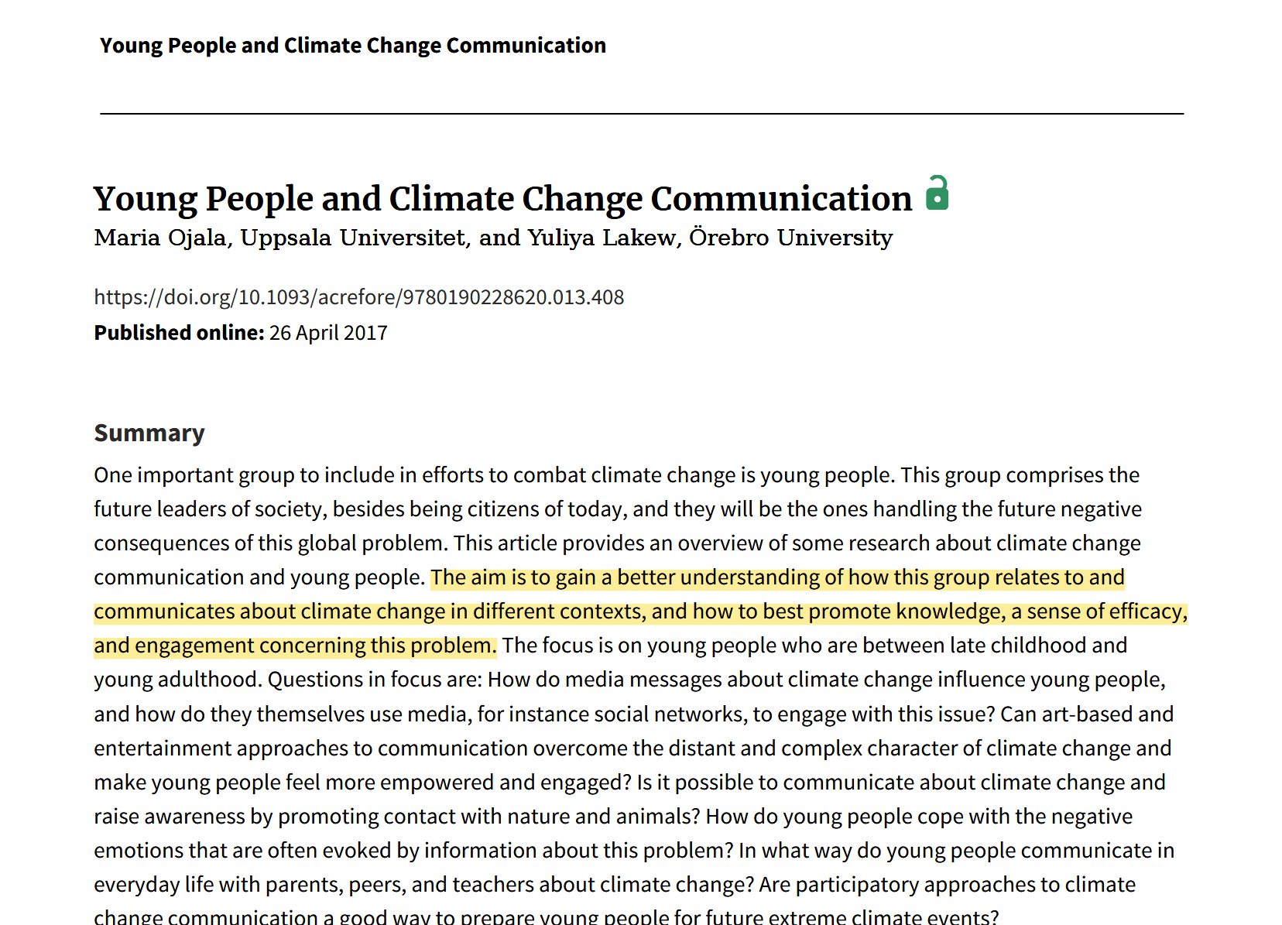
Ojala & Lakew (2017)
Notes:
More discussion with parents (in Sweden) the less likely they deemphasize the seriousness of the problem

Slide 5
Factors for Lower “Climate Engagement”
Factors for Higher “Climate Engagement”
Teens’ perceived lack of power (e.g., can’t vote)
Problem-focused coping strategies
Youth’s perception of climate change as distant
Social networks
Prior skepticism*
Online Discussions (Peers)
Teachers + Parents
Are any of these factors coming up in your work and discussion with the youth at Sayre? How has it affected your action/research projects?
Art-Based approaches**
Connecting to economic costs
*not a lot of quantified evidence
**objective information might be less influenced by personal bias than information based on opinions or politics.
Notes:
More discussion with parents (in Sweden) the less likely they deemphasize the seriousness of the problem

Slide 6
We need more rigorous research in arts-based approaches!
Informing is easier than engaging… participatory methods might help.
Media is complex and uneven… different youth process media differently.
Youth care! But need support from peers, parents, an teachers to surface conversation.
We need to discuss speculative futures to foster both critical mindsets and hope in youth.

Slide 7
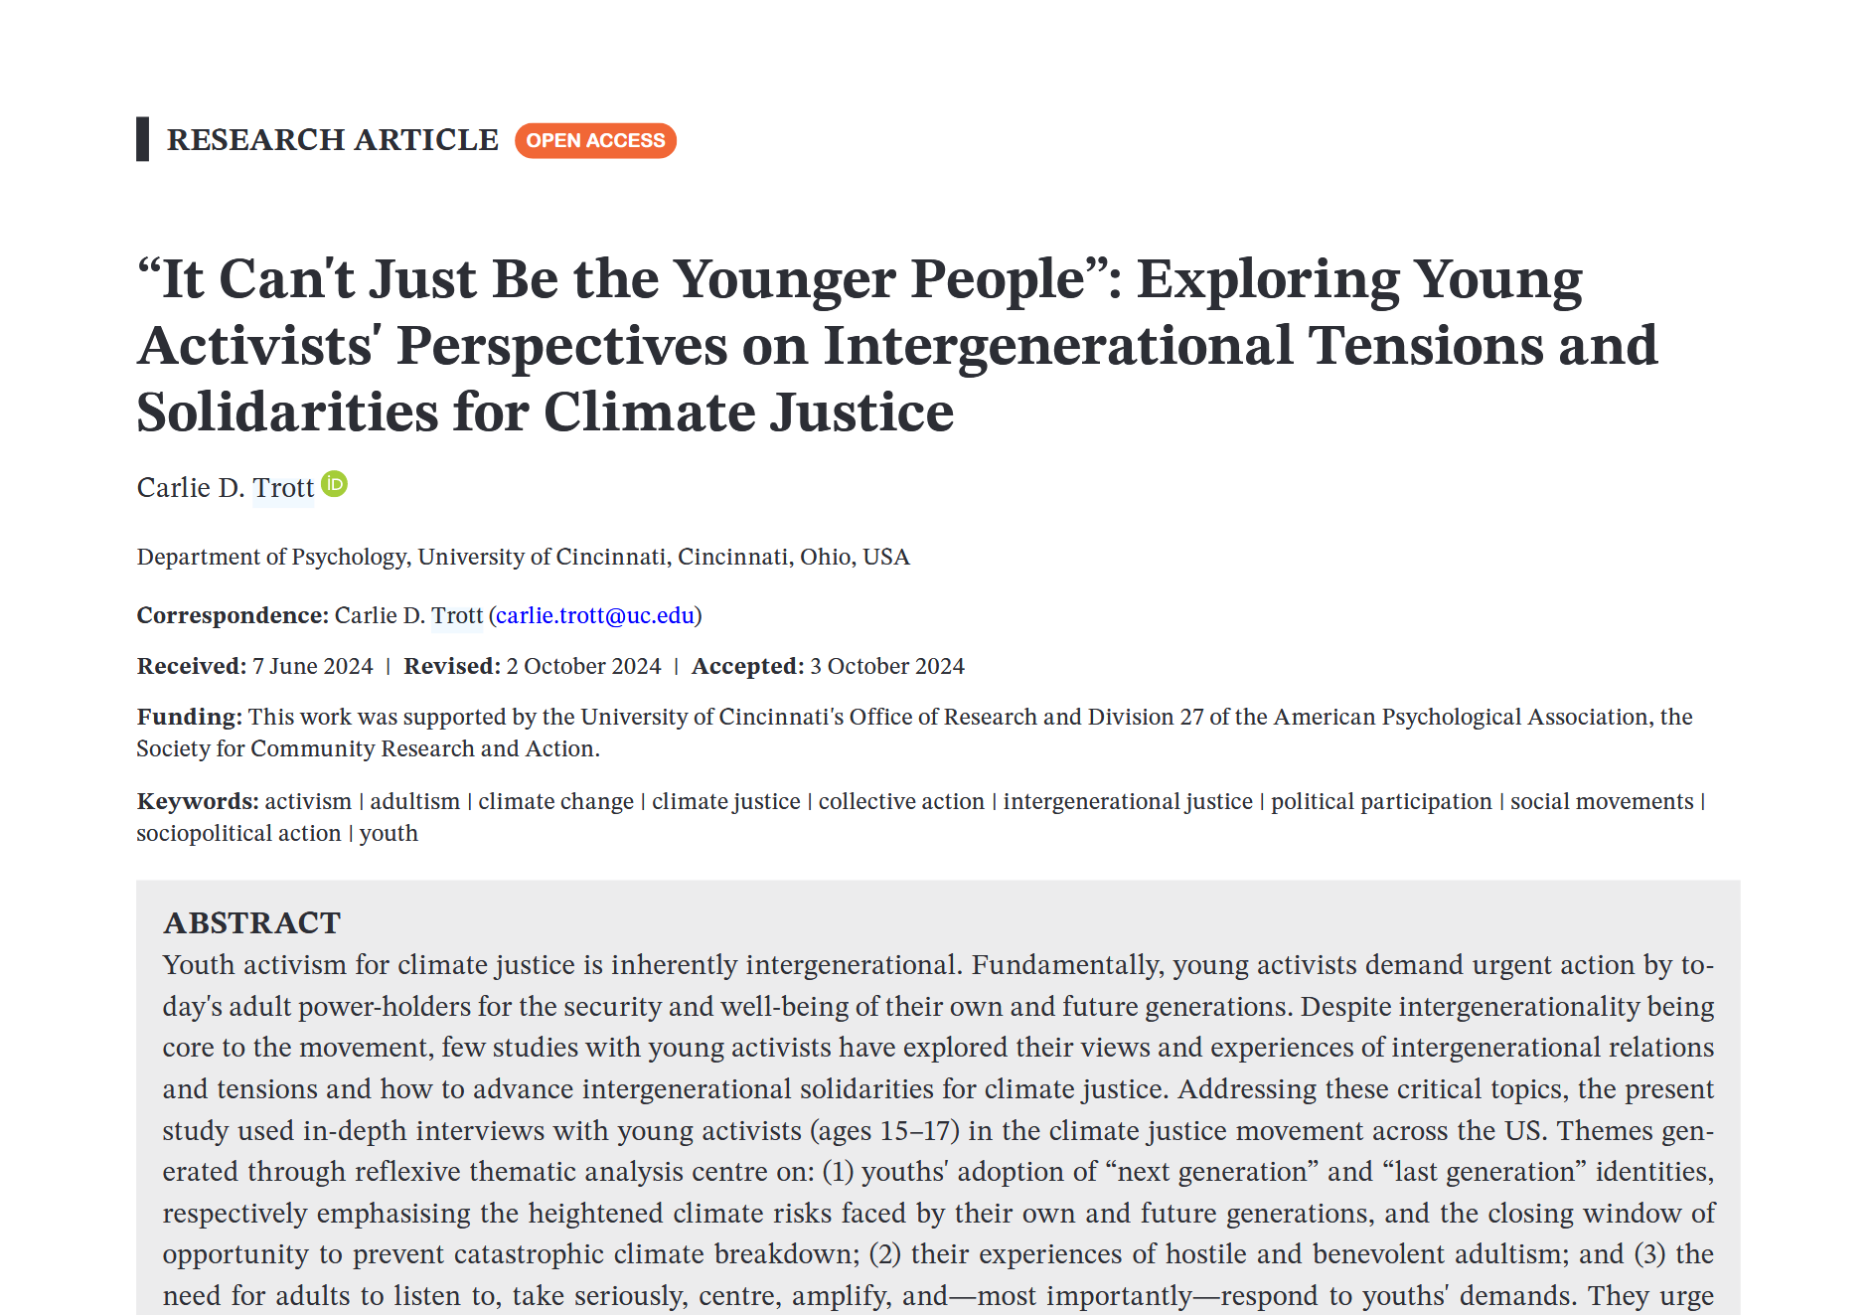
Trott (2024)
Notes:
More discussion with parents (in Sweden) the less likely they deemphasize the seriousness of the problem

Slide 8
Youth’s Intergenerational Frustration
Need for Adult Solidarity and Action
Emotional Labor and Burnout

Slide 9
This is our world and this is our future, and the sad thing is that I'm 15 and I need to start worrying about whether I'm gonna have a planet for my kids to live on and my grandkids, which is really terrifying. But it's also really motivating for me, because I know that I wanna change this world
I find activism to be very empowering and inspiring and something that I really enjoy doing. But I think there are times when I feel like I shouldn't need to be doing this. I shouldn't have to be 16 years old and ... fighting for the future of the planet. I feel like other people, adults should be doing that and we should be able to live the childhoods and youth that we want to.
The dynamic should change. I think that youth should be invited onto more ... councils and advisory boards in the government. And their voice should be included in the decision-making process as much as possible—or, even more than adults.

Slide 10
Participation & Power

Slide 11
bit.ly/ypar_power25
1. What does youth empowerment mean in the context of our actual practice—not as an idea, but as something we helped (or didn’t) foster?
2. What has felt like authentic youth participatory work?
3. What role did you (grad students or instructors) play in it?
4. How about the opposite – what has felt inauthentic?
5. Did power-dynamics shift across the different sessions? How so? What enabled it?

Slide 12
Debrief

Slide 13
Talk paper?

